Slide 1

Data Cleaning
Professor Bo Liu
James Watt School of Engineering

Slide 2
What is data cleaning?
In a data set, some data can be:
Incorrect/incorrectly formatted
Missing/incomplete
Duplicated
A row/column with the same value
Data cleaning is about to fix these problems

Slide 3
Benefits of data cleaning
Improving data quality
  Inconsistencies and inaccuracies removed.
  Time saved as errors are identified beforehand.
Optimizing model training
  Cleaned data is easier to analyze, and the results are more accurate.

Slide 4
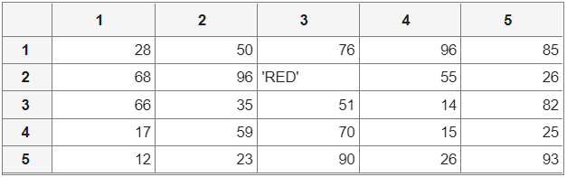
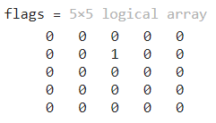
Identify the incorrect data
Incorrect data (cell array)
Related functions:
isnumeric
The weight column, entries that are not numeric should be identified
% Sweeping through all elements
for i = 1:5
for j = 1:5
% if the entry is not numeric, assign a 1 to the corresponding entry
flags(i,j) = ~isnumeric(data_incorrect{i,j});
  end
end
flags
See live script

Slide 5
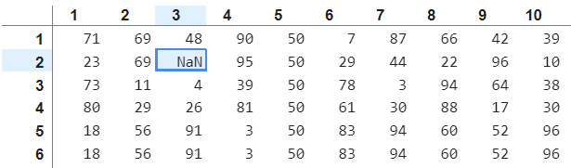
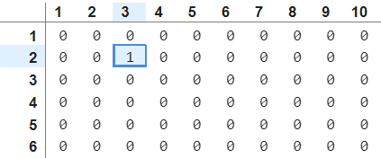
Identify the missing data
Missing/incomplete data
Related functions:
ismissing
% Identifying missing data, missing data entry is indicated with a "1"
ismissing(dat1)
See live script

Slide 6
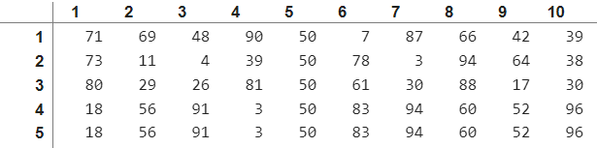
Remove the missing data
Missing/incomplete data
Related functions:
rmmissing
% Removing data samples with missing entries
[cleanedData_removal, ~] = rmmissing(dat1)
See live script

Slide 7
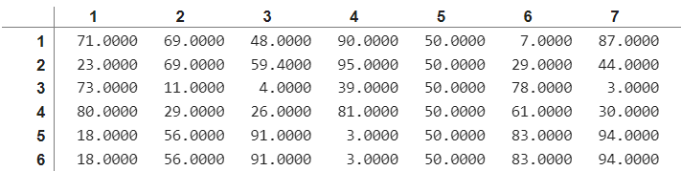
Fix the missing data
Missing/incomplete data
Related functions:
vecnorm
sort
mean
Query sample
Data samples
Target value
% Finding the k nearest neighbors from the incomplete data point by Euclidean distance
distance = vecnorm(dat1([1,3:end],[1:2,4:end]) - dat1(2,[1:2,4:end])', 2);
[~, ind] = sort(distance);
% Assigning the average to the missing value
dat1(2,3) = mean(dat1(ind(1:5),3), 1);
See live script

Slide 8
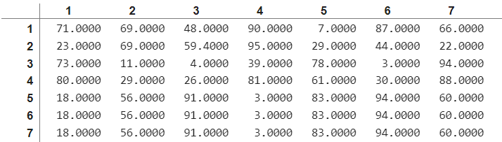
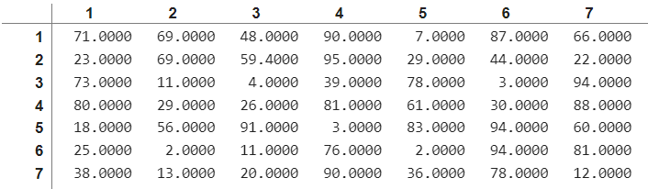
Clear duplicated rows
Duplicated data
Related functions:
unique
% Finding unique data points
dat1 = unique(dat1,'rows','stable')
See live script

Slide 9
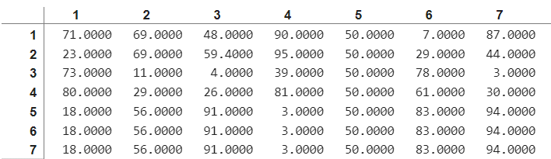

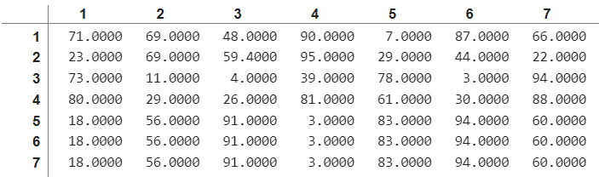
Clear a column with the same value
A column with the same value
Related functions:
var
% Finding the variances of each column
dat1_var = var(dat1, 1)
% Removing abundant columns with 0 variance
dat1(:,dat1_var ==0) = []
See live script

Slide 10




Thanks!
#UofGWorldChangers
@UofGlasgow

